Slide 2
Notes:
If asked on the spot, most people would be able to identify the major items of value in their homes, but would be unable to demarcate every item in every drawer. In addition, the emergent value of items in a home is cumulative; small, seemingly insignificant items can add up quickly in quantity and cost when viewed in aggregate (e.g. a large spice rack or cabinet in a kitchen).
FEMA’s National Flood Insurance Program (NFIP) Notice of Loss form requests over 40 different types of documentation necessary to file a claim, included current lienholder information, pre- and post-loss inventories, replacement cost estimates, Condominium association by-laws and financial statements, among others. In a post-disaster situation, victims are already overwhelmed with the loss of their home, and are often unprepared to handle the administrative overhead required to begin the claims process.
As of 2012, Facebook processes more than 300 million new photo uploads each day. (Source: http://news.cnet.com/8301-1023_3-57498531-93/facebook-processes-more-than-500-tb-of-data-daily/) These images are of a broad variety of things: friends, places traveled, events attended, and also of your home. Over time these images accumulate and are tied to your social media identity, ready to call up at a moment’s notice, even long after the documented event has passed.

Slide 3
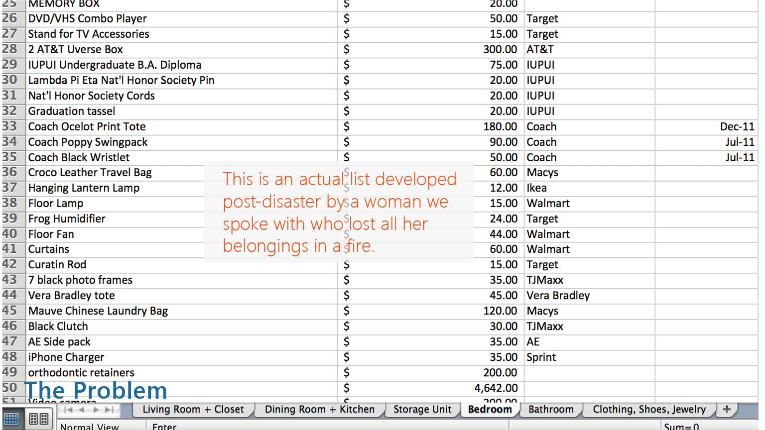

Slide 4
Notes:
Traci lost all of her possessions in a house fire in June of 2012. While she was fortunately not in her home at the time of the fire, she was nevertheless confronted with the daunting task of attempting to identify all of the items that were destroyed. She needed to compile a large 7-page spreadsheet by hand, detailing room by room the items she could identify for her insurance claim. Due to protracted legal proceedings (her apartment complex was at fault for the fire), her inventory was required to be updated and revised multiple times. This caused her additional emotional stress as she was forced to revisit the effects of the disaster again and again over a 9 month period leading up to her settlement.
David Wild is an Associate Professor at Indiana University's School of Informatics and Computing who holds holds a FEMA Professional Development Series (PDS) certificate in emergency management. He specializes in the use of social media in emergency management, and was featured in a 2010 CNN article on the use of social media in the Colorado Wildfires.
We spoke with Cindy, a local agent for a large insurance company, about the claims process and interaction between a disaster victim and their insurer. She validated our findings that much of the inventory process is still done by hand on paper, and that the most successful claims are those that at least have some documentation prior to the loss. In addition, Cindy emphasized the importance of keeping a remote copy of your inventory outside of the home; a home inventory left only in one location risks being lost along with a person’s possessions.

Slide 5
Notes:
We examined many different sources for our secondary research: local and federal disaster-relief agencies, documentation from insurance companies, and white papers from various technological and service oriented organizations. At the intersection of image recognition, social media aggregation, and planning strategies for disaster relief, our concept began to develop. Below is a summary of the three most influential resources we drew upon for the direction of our concept.
Google Crisis Response: Google’s collection of first-responder tools focuses on delivering accurate, timely information across a wide range of platforms and channels. This is accomplished using a holistic application of several of their core web services in concert: including Google Docs, Spreadsheets, Maps, Google Earth, and Google Sites. As a packaged product, these services allow rescue teams to build customized maps to outline areas affected by a natural disaster to direct volunteer resources and supplies, for example, or allow workers on the ground to switch between prepaid phones while still maintaining the same number using Google Voice. We found this model compelling because it demonstrates the ability of web-based services to be appropriated for a specialized purpose. Google allows agencies the freedom to adopt their own emergent uses for their products, and then incorporates the most common or successful into new features or forks of their base product offering.
Kinect Room Mapping and Object Recognition: The Kinect as an interaction medium is powerful for its ability to map objects in three dimensional space, both as static rooms and as objects in space. In addition, the Kinect is very adaptable as a rendering device, capable of mapping and recognizing objects in real-time, updating the drawn map as the object or viewpoint is shifted. Projects like KinectFusion, a collaboration between Microsoft Research Cambridge and several universities, demonstrate the ability of the Kinect to be more than a passive monitoring tool capable of creating highly detailed and actionable image information.
FEMA Emergency Financial First Aid Kit: Our decision to focus on inventories was derived in large part from FEMA’s many natural disaster “checklists,” available online. In particular, a checklist for important legal documents and financial statements caught our attention due to its length: at more than 50 items, we envisioned the time commitment needed to find or acquire all of these items would be substantial. With this in mind, we started to iterate on alternative ways of documenting a home inventory, keeping in mind that minimal upfront time investment was key.

Slide 6
Notes:
Our research led us to a series of key insights about home inventories, and how available and upcoming technologies could be leveraged to make the process of creating an inventory a gradual and more incremental process.
In our interview with Traci, she described to us a recurring scenario where she would receive a call from her attorney who was handling her claims case for the fire. Each time the attorney called, it typically involved a modification of her inventory, and Traci was forced to revisit the memories of the house fire in order to recall additional items she lost; she told us this made her feel angry about the event (in her situation, the fire spread to her apartment due to negligence on the part of the leasing company). This constant reliving of the disaster through the loss of one’s possessions became a key focus point for our concept; the disaster itself is already a tragic event, and we sought to design for a solution that would help to minimize the need to “reopen the wounds” associated with documenting loss.
By the same token, many of our sources from FEMA and other disaster preparedness organizations and the local and federal level emphasized the importance of preparing a home inventory prior to a disaster, but offered little in the way of structured guidance for how to do so. Our discussions with our usability participants and Cindy V., a local insurance agent in the area, indicated the prospect of constructing an inventory from nothing served as a key barrier to entry for many people. We used this feedback to focus on the micro-interactions of building an inventory over time, treating it as a series of many smaller tasks, rather than a single activity.
Lastly, our technological implementation of our concept was influenced by the ready availability of sophisticated and high-resolution cameras (such as those found in the Kinect and many modern smartphones) that allow for rich image documentation of a space. We later discovered the potential for social networks such as Facebook or Instagram, serving as giant repositories for situated images of a person’s daily life, to also play a role in the documentation and inventory process. Combining these two items together: the prevalence of high-resolution cameras in mobile devices and the seamless transfer of those photos onto social network, yielded our core concept of inventory management and preservation.

Slide 7
Notes:
Help build an inventory of possessions: During our conversation with Traci, we learned that having to come up with an inventory of possessions that were destroyed was a pain point. Similar to opening up a scar that is trying to heal, she talked about the back and forth with the insurance company metaphorically ripping the scab off. Our app could be used as a way to streamline the claim process by giving people a way to quickly come up with an inventory of possessions using data that they previously did not realize could be helpful.
Streamline insurance claim process: The back and forth between homeowners and insurance companies occupies time and resources. If there was less haggling back and forth with claims, all parties (FEMA, homeowner, insurance company) could benefit. By improving turnaround time on claims and giving out more accurate sums of money to replace goods, relief could more urgently be disbursed to victims.
Regenerate material life: The rebuilding aspect of a disaster is still a part of the disaster. When a homeowner loses their home and possessions, they don’t magically get replaced by the insurance company the next day. Our app doesn’t completely solve the problem, but it could help alleviate the stress of having to regenerate their material life after a disaster.

Slide 8
Notes:
To help convey our concept, we used a persona who lives in a high-risk area for wildfires. We chose to use the threat of wildfire in the story because it was the disaster that most closely tied to our primary research. Sarah’s story was inspired by the first hand account we heard from Traci, who lost all of her possessions in an apartment fire. The beginning of the story has our persona Sarah getting evacuated from her home as the wildfire is spreading. We recognize that the most primary need a person has in a disaster is to find safety first. We felt this step needed to be shown to situate the timing of when our application could become useful.

Slide 9
Notes:
Using the insight we gained from professor David Wild (who holds holds a FEMA Professional Development Series certificate) who pointed out that “once the feeling of personal/familial safety is assured (during a disaster), next comes addressing the threat to property,” we situated our concept in the space immediately after physical safety is attained. In Sarah’s case, she receives bad news that her house has been destroyed by fire, so she shifts her focus to her possessions.
At this point, our research shows that panic can set in with the homeowner. During an interview with an insurance agent from a major insurance company, we found evidence why panic would set in for a homeowner. When asked about the specific of what a good home inventory looks like, the agent pointed out, “If a home inventory is in a shoebox under the bed, it won’t do any good.” Additionally, many we learned that “people will remember the big things, but it’s the little things that add up” in regards to creating an inventory of possessions. Using these two insights, we chose to highlight the fact that she has homeowners insurance in the story because a common misconception among people who have homeowners insurance is that they are “fully covered” by homeowners insurance. In a broad sense, the goal of this step of the scenario is to give the reader an opportunity to empathize with the sinking feeling of loss and not having all of their bases covered when a disaster hits.

Slide 10
Notes:
We chose to introduce the app into Sarah’s story after she experiences the feeling that she has lost everything to highlight a worst case scenario for our persona. It would be easy to show how our concept could work from the perspective of a person who prepares for disaster by documenting home possessions on a frequent basis using the app. People may not always be prepared, which is why we chose to focus on the person who has lost their home and are now faced with the frightening reality of having to piece together a list of possessions with only their memory to rely on.
The initial screen of the app gives a brief explanation of its potential benefit. We learned during the evaluation of our concept that people did not initially understand the benefit of the app when they opened it up. As a result, we added a brief overlay prior to the login step that gives a quick one sentence pitch to the individual of why the app is useful.

Slide 11
Notes:
To highlight how the Purchases category could be useful for establishing a home inventory, we chose Amazon. Other retail companies that could fit into this category are Lowes, eBay, Home Depot, Bed, Bath and Beyond and Best Buy. Using OAuth logins within the app to pull in purchase data from various online retailers will allow homeowners to piece together a list of items lost during the disaster.
Additionally, we see financial institutions/e-payment options (Credit Cards, Debit Card, PayPal) fitting into the purchases category. Using Mint as an exemplar for our concept, we know that it is possible to categorize purchase data in a way that would allow the app to make a list of purchases that could be relevant to the home. For example, it could filter our gas and grocery purchases and pull in retail purchases. We discussed as a team establishing a purchase amount threshold for transactions ($50 was our proposed threshold), but recognize that more research would have to be done to establish a firm number. We also recognize a current limitation of using bank and credit card purchase history is parsing a big purchase into itemized lists of items. Moving forward we would seek to address that problem, but we also see benefit in listing out purchases that may relate to household possessions.

Slide 12
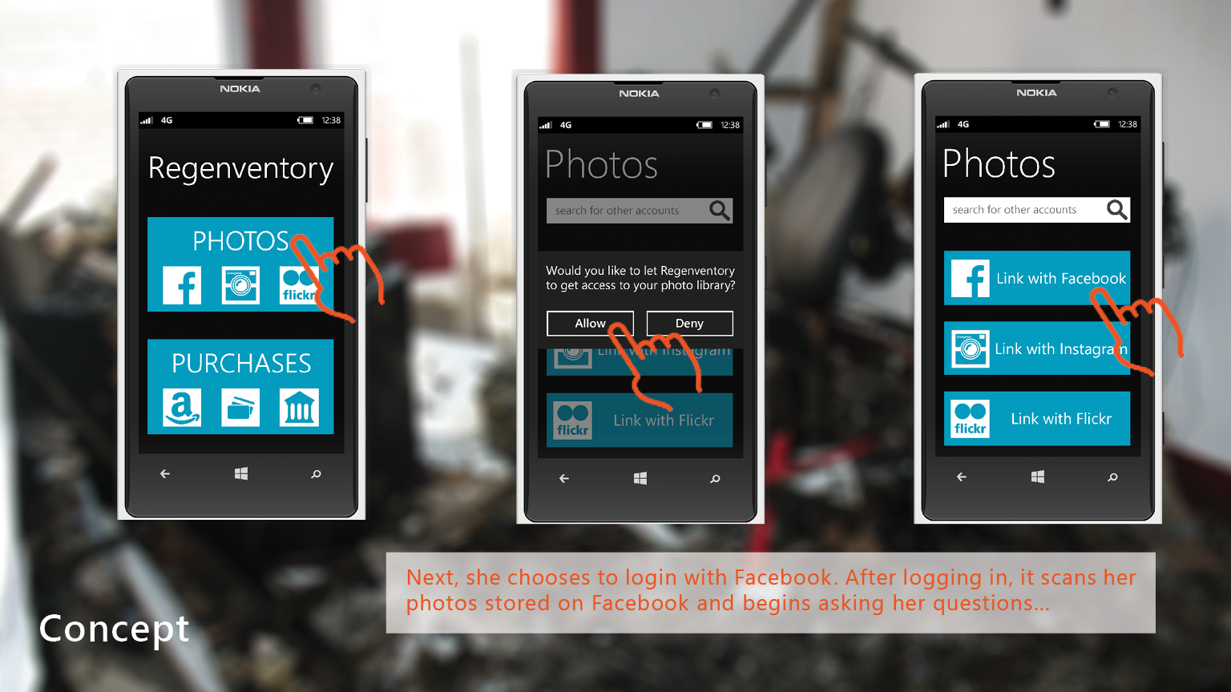
Notes:
During our concept evaluation, we learned that people did not understand why they would need to log into the app with their social media logins. As a result, we created a higher level category called “Photos” to tie the social media login step to purpose. In other words, a person would need to click photos before they log in with their Facebook account. The extra step will help clarify that they are logging into an account with an intent to allow access to photos.
The core idea of our concept is centered around the interaction between the app and the person after the app scans their photos from a specific social network. When a person grants the app access to photos, the app would use image recognition to detect interior rooms in the background of photos. The interaction removes the cognitive burden of having to recall possessions from memory with a simple call-and-response dialog similar to 20 Questions.

Slide 13
Notes:
When the person confirms that one of the photos shows the interior of their home, the app will populate a list of possessions shown in each photo. Using image recognition and yes/no confirmation from the person being shown photos, an inventory of possessions could be rapidly developed with minimal effort. The app would attempt to categorize each item shown in the list to allow for sorting. Also, each photo would have its own individual list of items, rather than producing one big list of items for multiple photos. We saw that as important because it would allow a person to systematically go through each photo to edit items shown in individual photos.
We discussed including cash value or replacement value of items shown in the list, but decided the feature was out of our concept’s scope. We talked about giving a range of values (i.e. $100-$300) for items or a maximum value for an item, but recognized that the pricing feature could distract from our core idea of building an inventory.

Slide 14
Notes:
Itemized inventory: If financial institutions could give more specificity to purchases made with credit and debit cards, more information could be gathered by the app. Currently, financial institutions can classify purchases into broad categories, but if a person were to make a $200 purchase at Best Buy, there would be no way to tell what items were purchased.
Insurance fraud concerns: We recognize that people would have many opportunities to falsely claim that photos of other peoples’ houses are theirs. With more and more photos offering location information as part of the metadata, we believe the initial photo recognition scan done by the app could be improved to limit this type of fraud.
Insurance company recruitment: Based on our research, insurance companies make an effort to try to get homeowners to create a personal inventory when they initially purchase homeowners insurance. Since they have a vested interest in helping their customers out by reducing the trauma of replacing lost possessions after a disaster, it could be inferred that they would have an interest in backing the app.

Slide 16
Notes:
During our testing, we discovered that many of our participants struggled with our initial screen, which combined both a login screen to the service and options for connecting social networking accounts. They stated that they weren’t sure what the purpose of logging in initially was, and the transition between login and analyzing images in a single interaction was jarring for them. One of our participants also stated that on the results page he would like to be able to easily filter out or edit the results of the image analysis, removing items that he deemed incorrect or not relevant to his inventory. We incorporated this feedback into our redesign of our concept and the resulting high fidelity key comps.
In our third usability test, we presented our participant with a revised version of our application. While observing her progress through the scenarios we presented, the core purpose and functionality of the application appeared to be more readily understood, and prompted questions and comments that were task-specific. In particular, she indicated her preference to use the financial search rather than the photo search, due to her personal tendency to not take many photos with her phone. However, one photo-specific question raised by this participant alerted us to a use case we had not originally considered: in the event that the person using the application did not have their phone (either due to loss or lack of battery power, for example) and instead was using a friend’s phone to document items, how would our system determine which person’s data to analyze? While individual login profiles could provide one approach to this problem, we found it an important consideration, given the nature of a disaster situation and the need to improvise in the moment. In this same vein, our participant recommended a web-based version of our application that could be synced across the two devices (i.e. mobile and desktop), ensuring that in the loss of the phone, the inventory would be backed up remotely for access elsewhere.

Slide 18
